Slide 1
Measuring Unwanted Traffic and Information Control: Measurement and Machine Learning
Nick Feamster Princeton University

Slide 2
Automated Filtering of Online Speech
Automated Filtering of Content
Automated filtering
Filter bubbles, personalization, and attacks
Day 1: Supervised Learning
Day 2: Unsupervised Learning
Day 2 (Bonus): Internet Censorship
Filtering and manipulation of Internet protocols
Stochastic detection

Slide 3
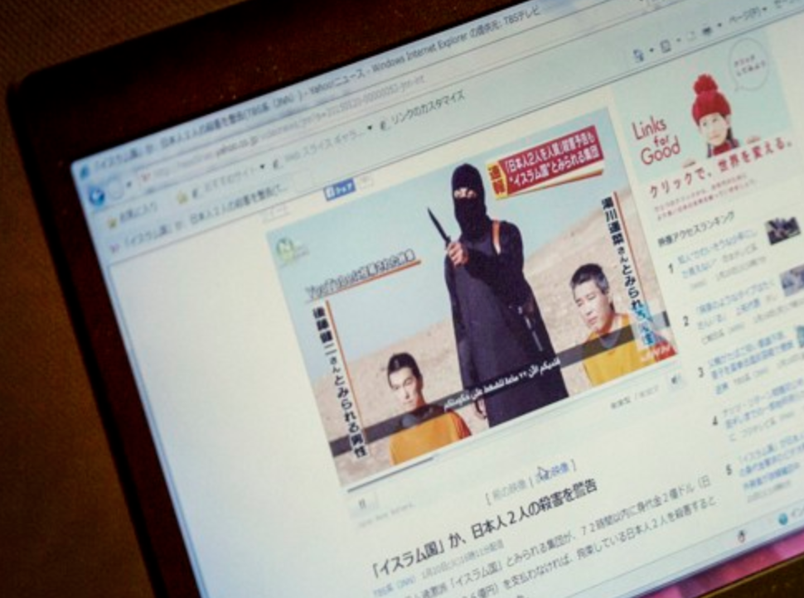
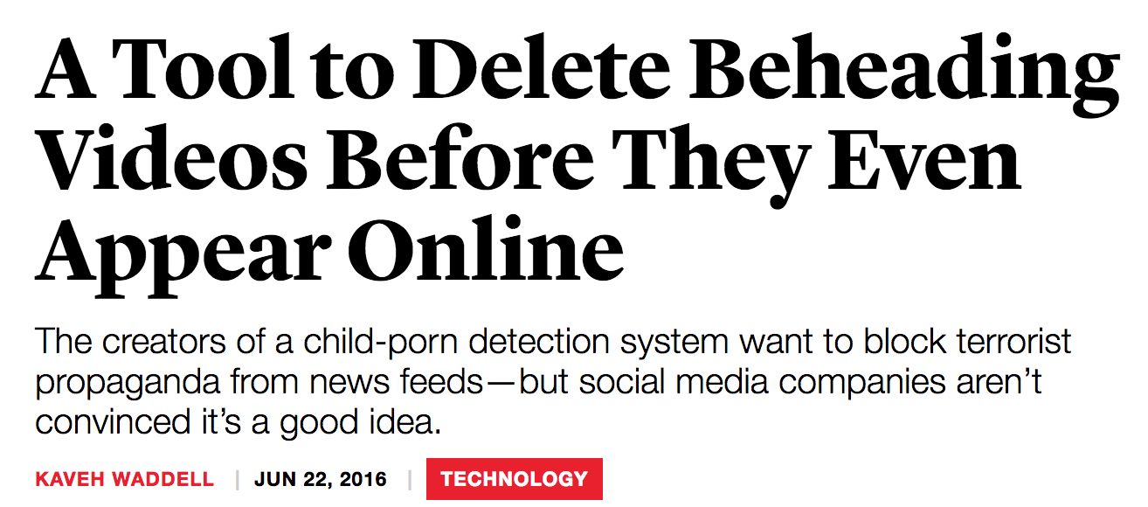
Automated Filtering and Speech

Slide 4
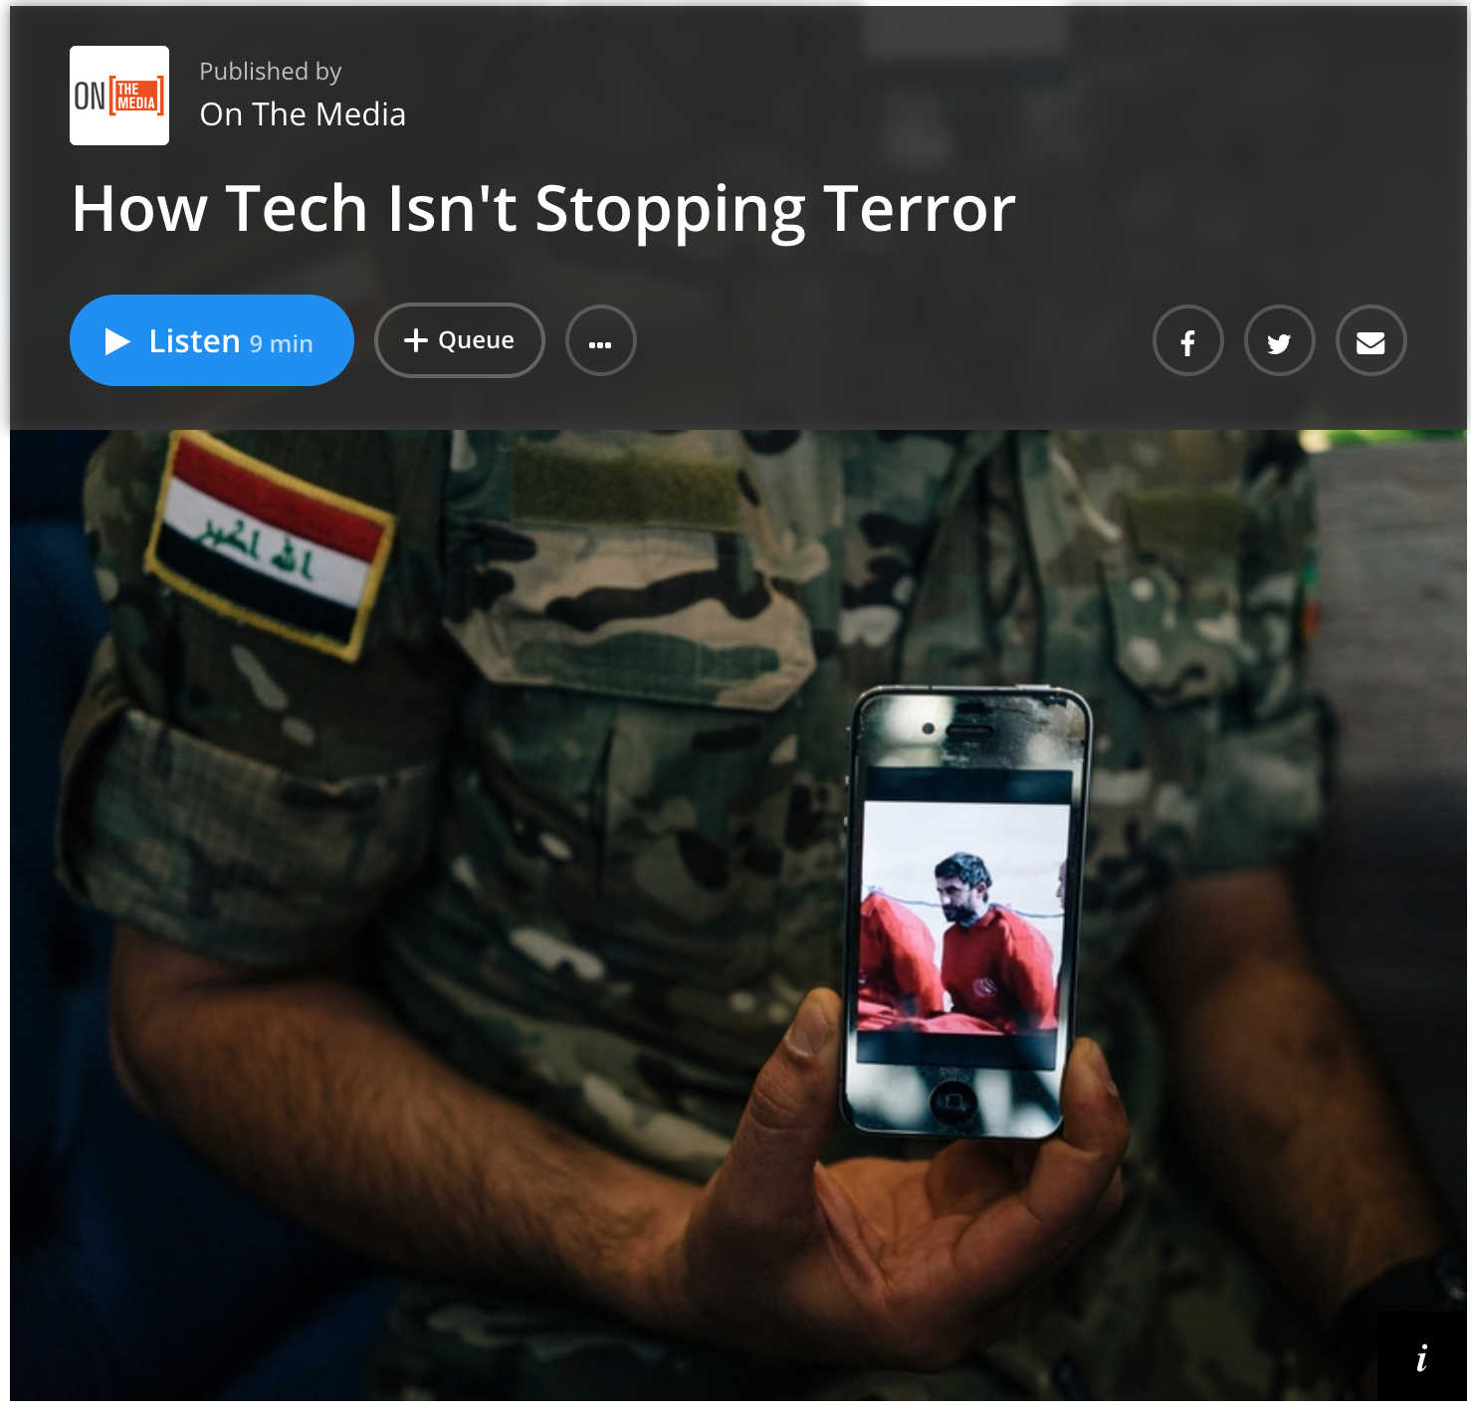

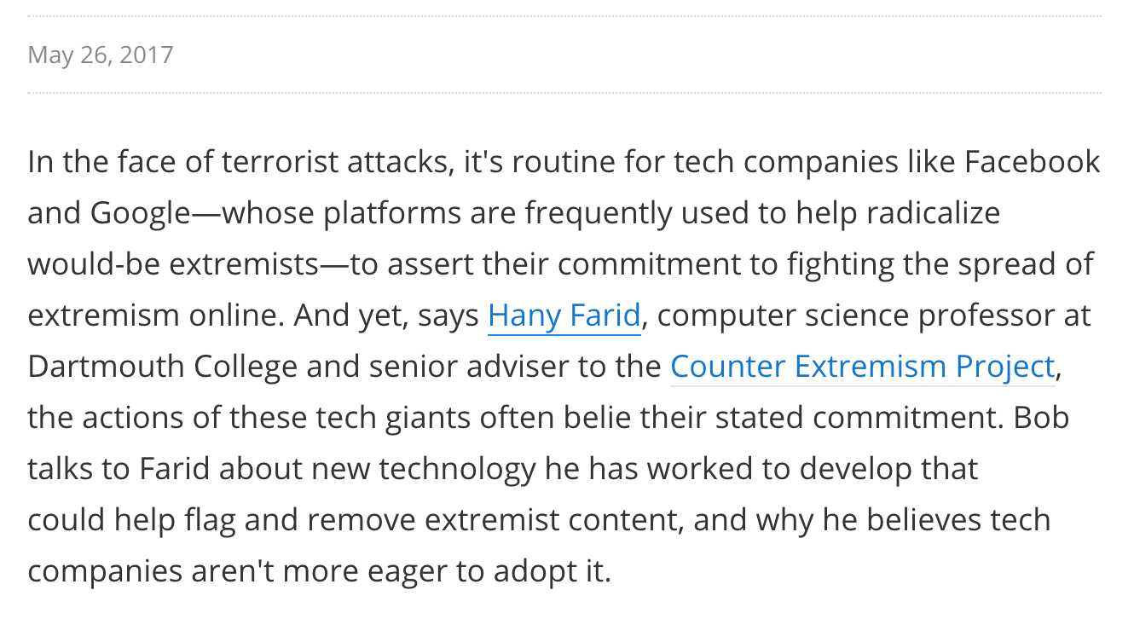

Slide 5
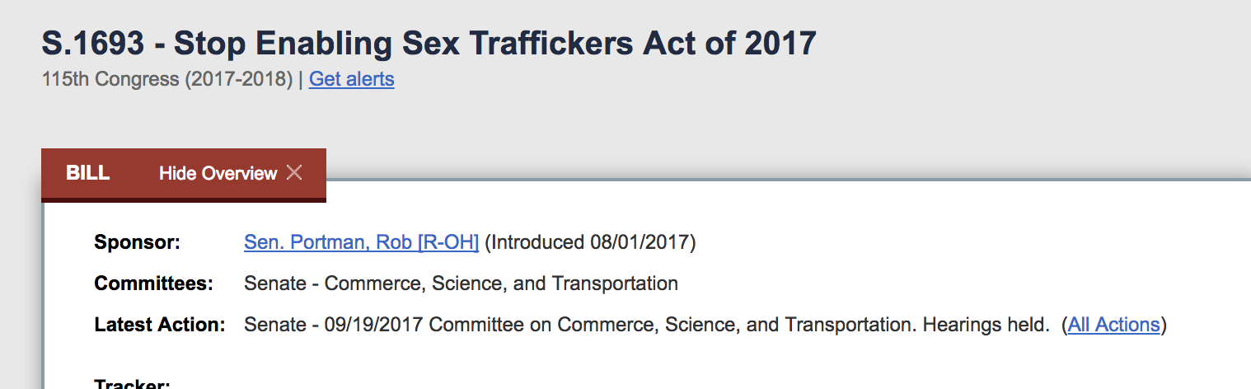
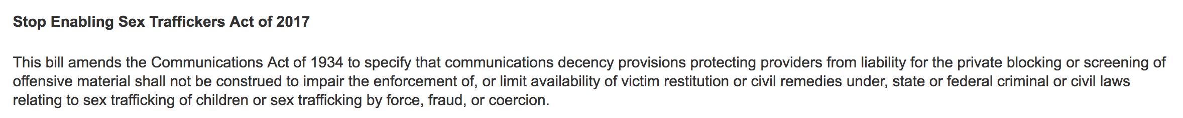
Most of tech industry opposes. Supporters include: Oracle, Motion Picture Association of America, …

Slide 6
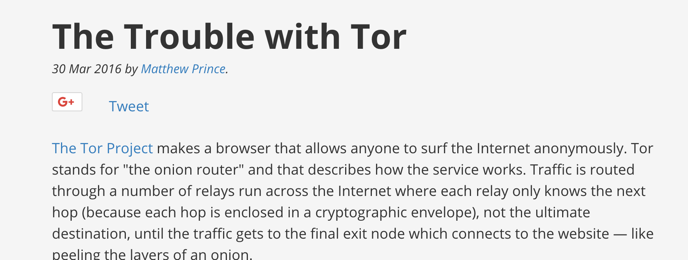
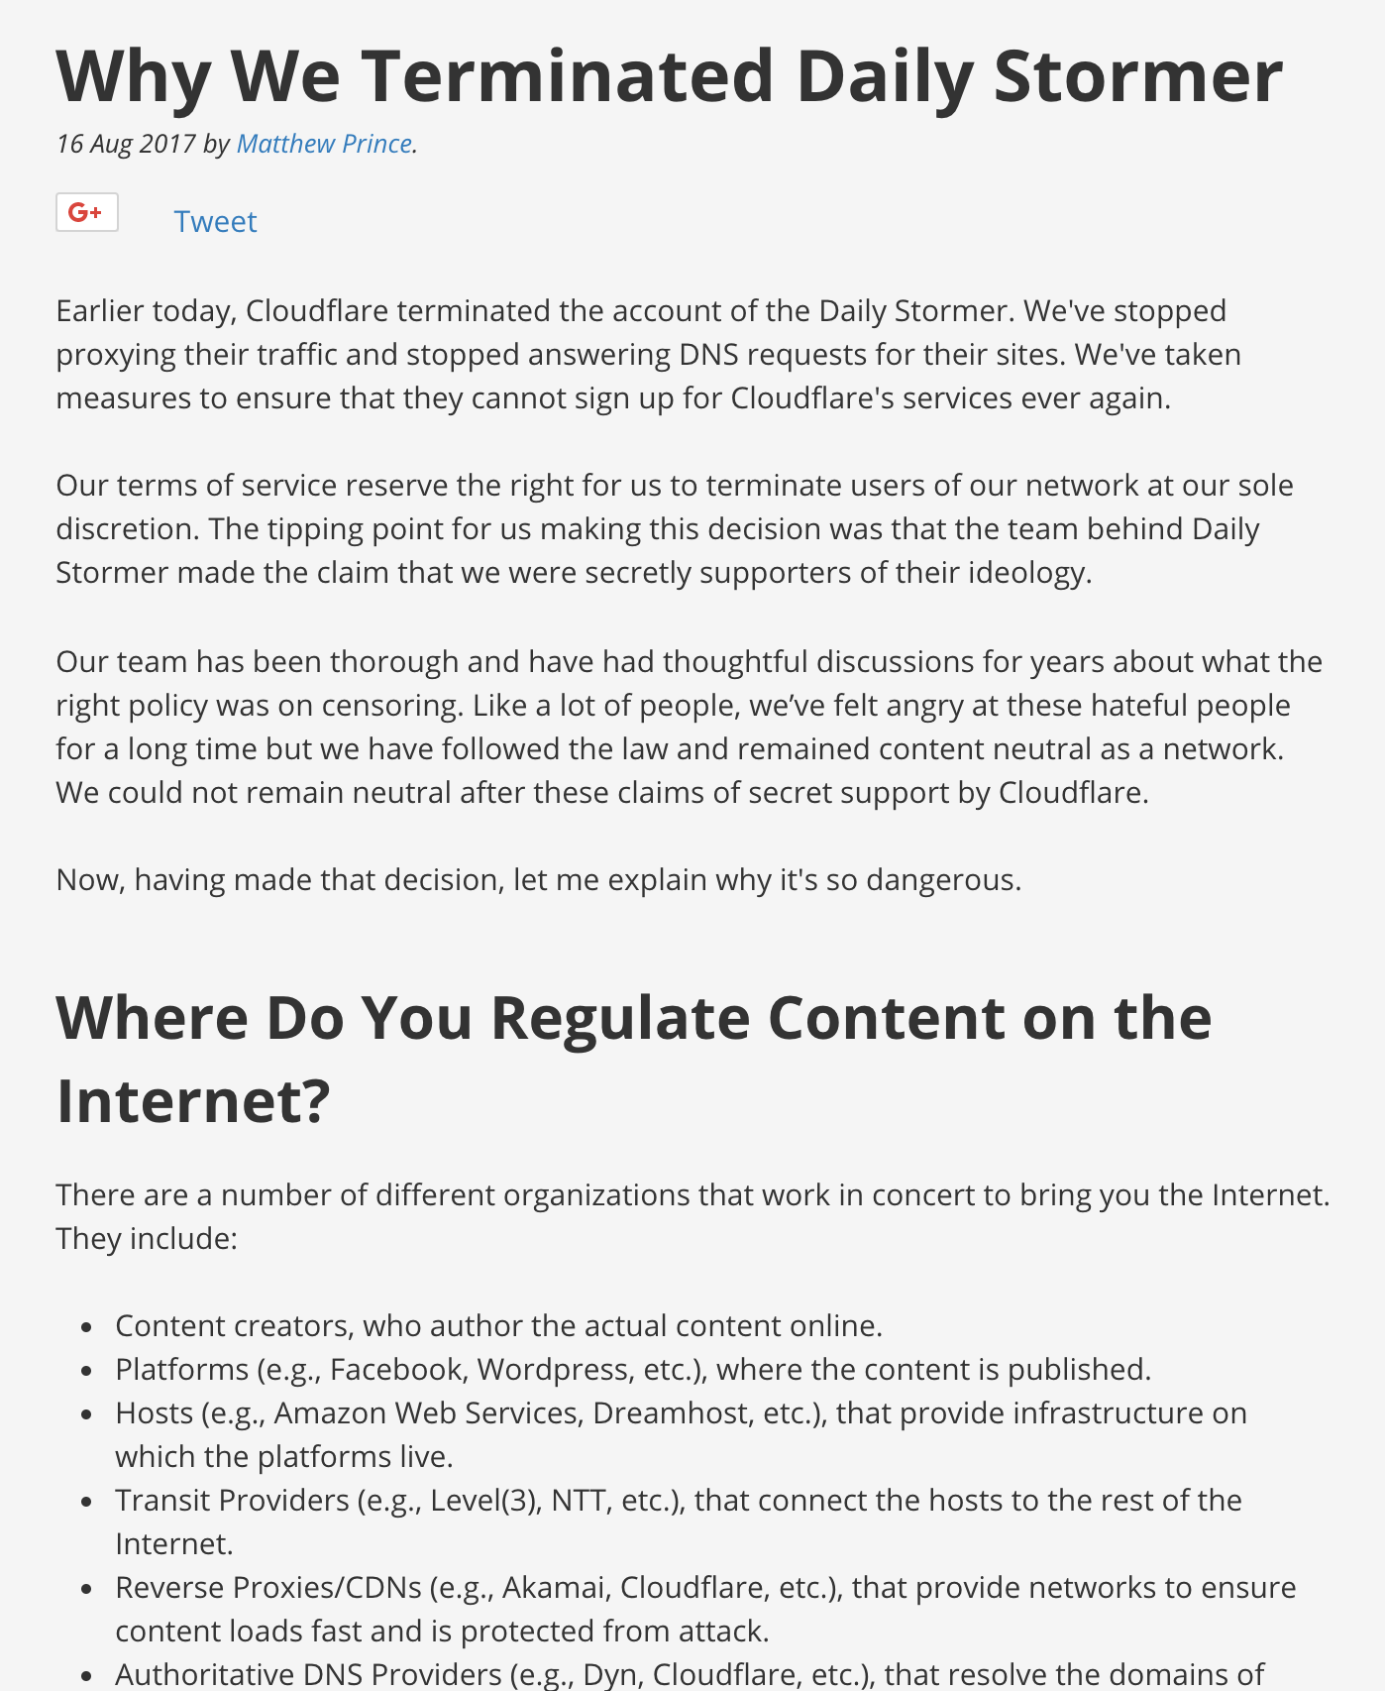

Slide 7
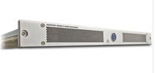
Background: Email Spam
Prevent unwanted traffic from reaching a user’s inbox by distinguishing spam from ham
Question: What features best differentiate spam from legitimate mail?
Content-based filtering: What is in the mail?
IP address of sender: Who is the sender?
Behavioral features: How the mail is sent?

Slide 8
General problem is much harder than spam, phishing, child porn…
Context
Fair use
Parody
…

Slide 9
Propaganda

Slide 10
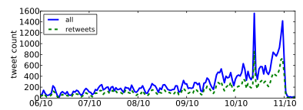
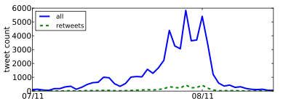
Detecting Propaganda
How can Twitter be used to affect public opinion?
Can we detect when Twitter is being used to spread propaganda?
Nevada Senate Race
Debt Ceiling Debate

Slide 11





Personalization as “Filter Bubble”
“A squirrel dying in front of your house may be more relevant to your interests right now than people dying in Africa”
– Mark Zuckerberg
Online personalization is creating situations where we only see things that already suit our own tastes.
Personalization can also be exploited.

Slide 12
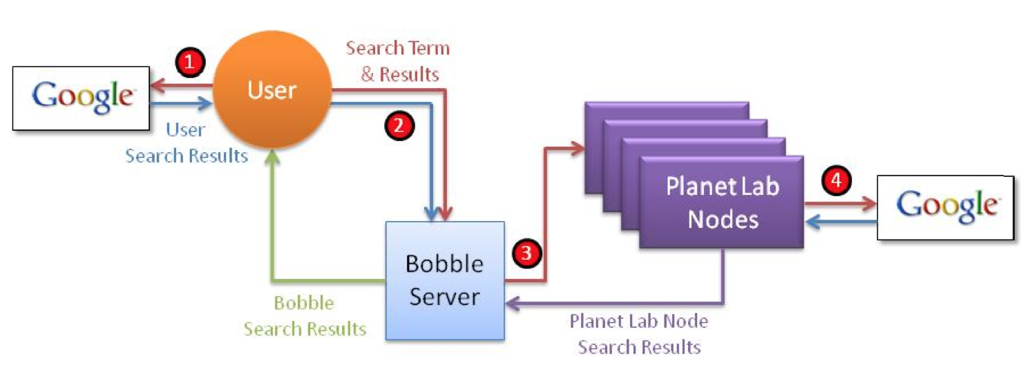
Bobble: Bursting the Filter Bubble
Execute query
As different users
Different vantage points
With different history (e.g., cookies)
Compare differences in results
What shows up on the first page?
Where does it show up?
When it doesn’t appear, what are the possible explanations?

Slide 13
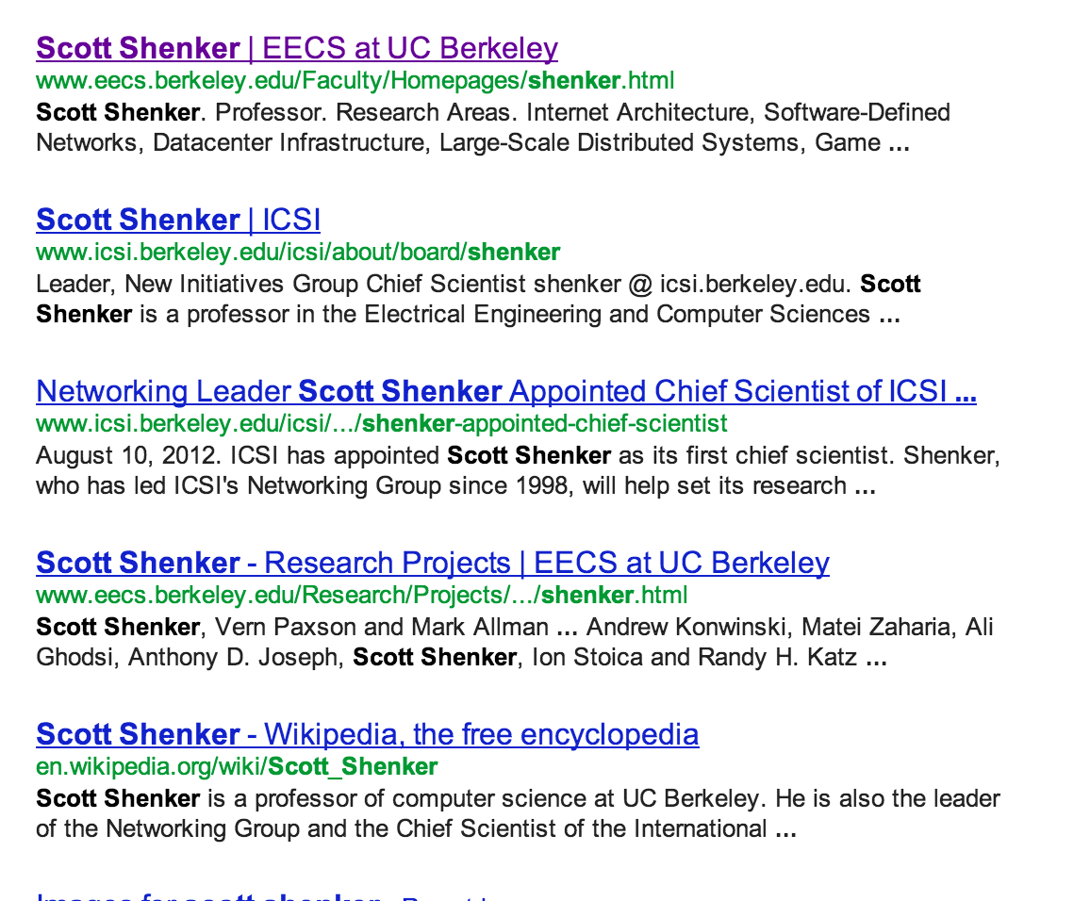
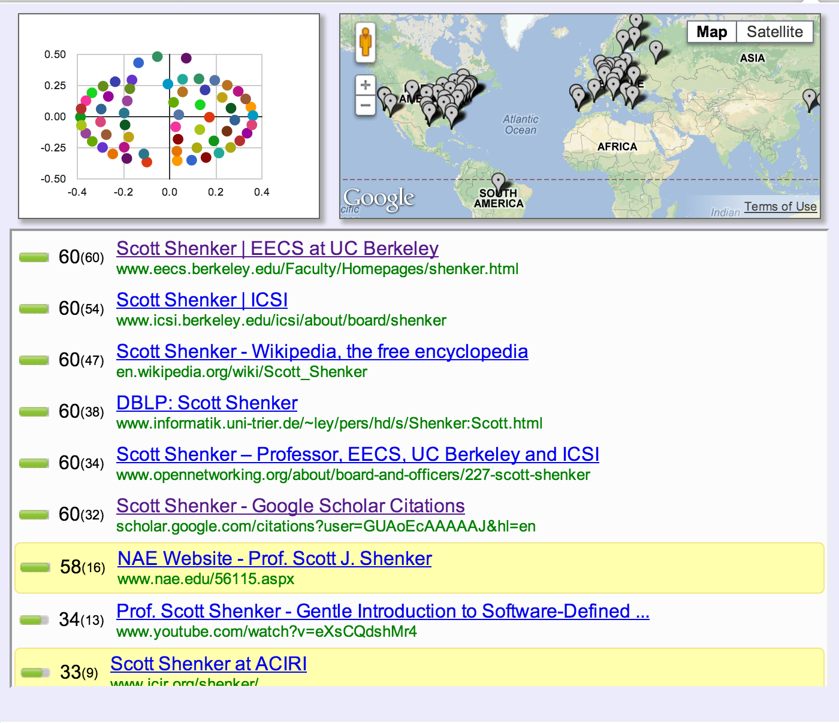
Things you didn’t see!
Xing, Xinyu, et al. "Exposing inconsistent web search results with bobble." International Conference on Passive and Active Network Measurement

Slide 14
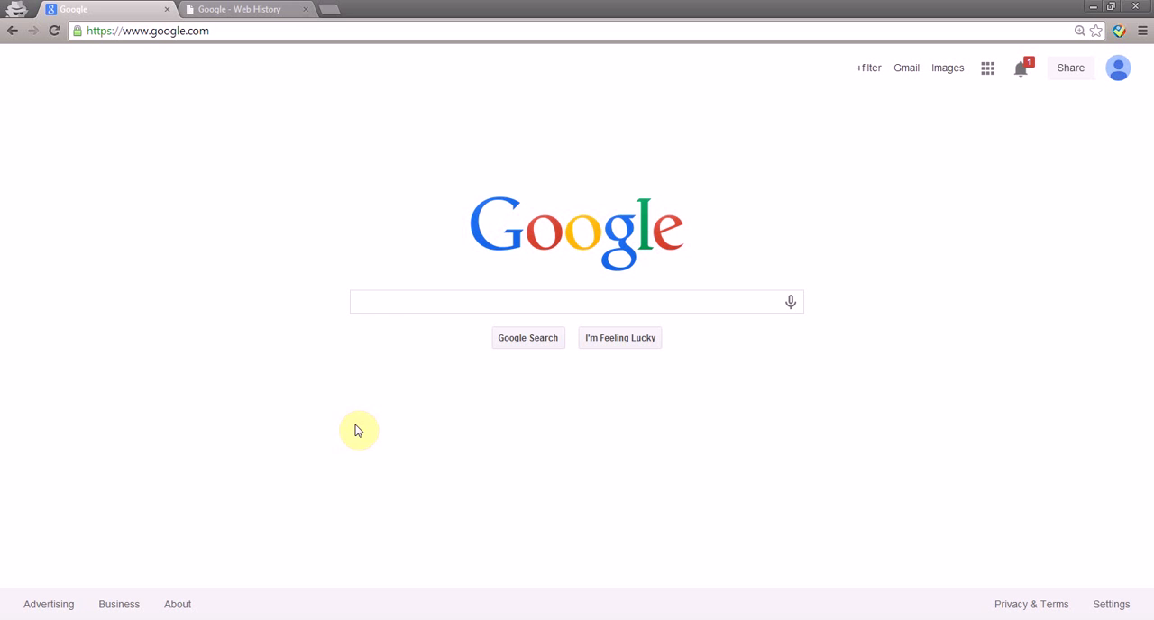
Pollution Attacks: Web Insecurity and Speech
Take This Personally: Pollution Attacks on Personalized Services. X. Xing, W. Ming, D. Doozan, A. Snoeren, N. Feamster, W. Lee. In USENIX Security Symposium, 2013.

Slide 15
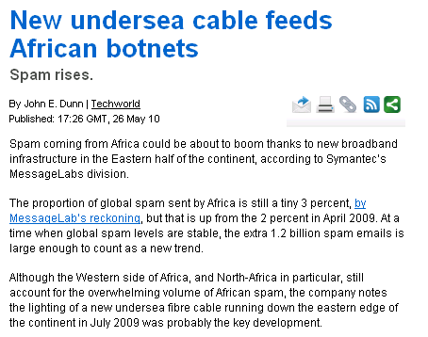
Spam in Africa: On the Rise
About 3.6 billion spam emails a day from Africa.
Up 50% from one year ago.

Slide 16
Approach: Filter
Prevent unwanted traffic from reaching a user’s inbox by distinguishing spam from ham
Question: What features best differentiate spam from legitimate mail?
Content-based filtering: What is in the mail?
IP address of sender: Who is the sender?
Behavioral features: How the mail is sent?

Slide 17

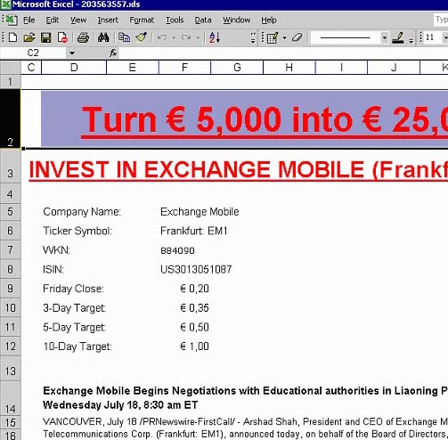

Approach #1: Content Filters
PDFs
Excel sheets
Images
...even mp3s!

Slide 18
Content Filtering: More Problems
Customized emails are easy to generate: Content-based filters need fuzzy hashes over content, etc.
Low cost to evasion: Spammers can easily alter features of an email’s content can be easily adjusted and changed
High cost to filter maintainers: Filters must be continually updated as content-changing techniques become more sophisticated

Slide 19
Approach #2: IP Addresses
Received: from mail-ew0-f217.google.com (mail-ew0-f217.google.com [209.85.219.217])
by mail.gtnoise.net (Postfix) with ESMTP id 2A6EBC94A1
for <feamster@gtnoise.net>; Fri, 23 Oct 2009 10:08:24 -0400 (EDT)
Problem: IP addresses are ephemeral
Every day, 10% of senders are from previously unseen IP addresses
Possible causes
Dynamic addressing
New infections

Slide 20
Idea: Network-Based Filtering
Filter email based on how it is sent, in addition to simply what is sent.
Network-level properties: lightweight, less malleable
Network/geographic location of sender and receiver
Set of target recipients
Hosting or upstream ISP (AS number)
Membership in a botnet (spammer, hosting infrastructure)

Slide 21
Why Network-Level Features?
Lightweight: Don’t require inspecting details of packet streams
Can be done at high speeds
Can be done in the middle of the network
Less Malleable: Perhaps more difficult to change some network-level features than message contents

Slide 22
Challenges
Understanding network-level behavior
What network-level behaviors do spammers have?
How well do existing techniques (e.g., DNS-based blacklists) work?
Building classifiers using network-level features
Key challenge: Which features to use?
Two Algorithms: SNARE and SpamTracker
Anirudh Ramachandran and Nick Feamster, “Understanding the Network-Level Behavior of Spammers”, ACM SIGCOMM, 2006
Anirudh Ramachandran, Nick Feamster, and Santosh Vempala, “Filtering Spam with Behavioral Blacklisting”, ACM CCS, 2007 Shuang Hao, Nick Feamster, Alex Gray and Sven Krasser, “SNARE: Spatio-temporal Network-level Automatic Reputation Engine”, USENIX Security, August 2009

Slide 23
Day 1: Supervised Learning

Slide 24
Top ISPs Hosting Spam Senders

Slide 25
Finding the Right Features
Goal: Sender reputation from a single packet?
Low overhead
Fast classification
In-network
Perhaps more evasion-resistant
Key challenge
What features satisfy these properties and can distinguish spammers from legitimate senders?

Slide 26
Set of Network-Level Features
Single-Packet
Geodesic distance
Distance to k nearest senders
Time of day
AS of sender’s IP
Status of email service ports
Single-Message
Number of recipients
Length of message
Aggregate (Multiple Message/Recipient)

Slide 27
Sender-Receiver Geodesic Distance
90% of legitimate messages travel 2,200 miles or less

Slide 28
Density of Senders in IP Space
For spammers, k nearest senders are much closer in IP space
Notes:
XXX Fix This XXX

Slide 29
Local Time of Day at Sender
Spammers “peak” at different local times of day

Slide 30
What is a Decision Tree?
An inductive learning task
Use particular facts to make more generalized conclusions
A predictive model based on a branching series of Boolean tests
These smaller Boolean tests are less complex than a one-stage classifier
Let’s look at a sample decision tree…

Slide 31
Predicting Commute Time
Leave At
If we leave at 10 AM and there are no cars stalled on the road, what will our commute time be?
10 AM
9 AM
8 AM
Stall?
Accident?
No
Yes
Long
No
Yes
Short
Long
Medium
Long

Slide 32
Sample Experience Table
Example | Attributes |  |  |  | Target
 | Hour | Weather | Accident | Stall | Commute
D1 | 8 AM | Sunny | No | No | Long
D2 | 8 AM | Cloudy | No | Yes | Long
D3 | 10 AM | Sunny | No | No | Short
D4 | 9 AM | Rainy | Yes | No | Long
D5 | 9 AM | Sunny | Yes | Yes | Long
D6 | 10 AM | Sunny | No | No | Short
D7 | 10 AM | Cloudy | No | No | Short
D8 | 9 AM | Rainy | No | No | Medium
D9 | 9 AM | Sunny | Yes | No | Long
D10 | 10 AM | Cloudy | Yes | Yes | Long
D11 | 10 AM | Rainy | No | No | Short
D12 | 8 AM | Cloudy | Yes | No | Long
D13 | 9 AM | Sunny | No | No | Medium

Slide 33
Choosing Attributes
The previous experience decision table showed 4 attributes: hour, weather, accident and stall
But the decision tree only showed 3 attributes: hour, accident and stall
Why is that?

Slide 34
Decision Tree Algorithms
The basic idea behind any decision tree algorithm is as follows:
Choose the best attribute(s) to split the remaining instances and make that attribute a decision node
Repeat this process for recursively for each child
Stop when:
All the instances have the same target attribute value
There are no more attributes
There are no more instances

Slide 35
Identifying the Best Attributes
Refer back to our original decision tree
Leave At
10 AM
9 AM
8 AM
Stall?
Accident?
Long
No
Yes
No
Yes
Short
Long
Medium
Long
How did we know to split on leave at and then on stall and accident and not weather?

Slide 36
ID3 Heuristic
To determine the best attribute, we look at the ID3 heuristic
ID3 splits attributes based on their entropy.
Entropy is the measure of disinformation…

Slide 37
Entropy
Entropy is minimized when all values of the target attribute are the same.
If we know that commute time will always be short, then entropy = 0
Entropy is maximized when there is an equal chance of all values for the target attribute (i.e. the result is random)
If commute time = short in 3 instances, medium in 3 instances and long in 3 instances, entropy is maximized

Slide 38
Entropy
Calculation of entropy
Entropy(S) = ∑_{(i=1 to l)}-|S_{i}|/|S| * log₂(|S_{i}|/|S|)
S = set of examples
S_{i} = subset of S with value v_{i} under the target attribute
l = size of the range of the target attribute

Slide 39
ID3
ID3 splits on attributes with the lowest entropy
We calculate the entropy for all values of an attribute as the weighted sum of subset entropies as follows:
∑_{(i = 1 to k)} |S_{i}|/|S| Entropy(S_{i}), where k is the range of the attribute we are testing
We can also measure information gain (which is inversely proportional to entropy) as follows:
Entropy(S) - ∑_{(i = 1 to k)} |S_{i}|/|S| Entropy(S_{i})

Slide 40
ID3
Given our commute time sample set, we can calculate the entropy of each attribute at the root node
Attribute | Expected Entropy | Information Gain
Hour | 0.6511 | 0.768449
Weather | 1.28884 | 0.130719
Accident | 0.92307 | 0.496479
Stall | 1.17071 | 0.248842

Slide 41
Problems with Decision Trees
While decision trees classify quickly, the time for building a tree may be higher than another type of classifier
Decision trees suffer from a problem of errors propagating throughout a tree
A very serious problem as the number of classes increases

Slide 42
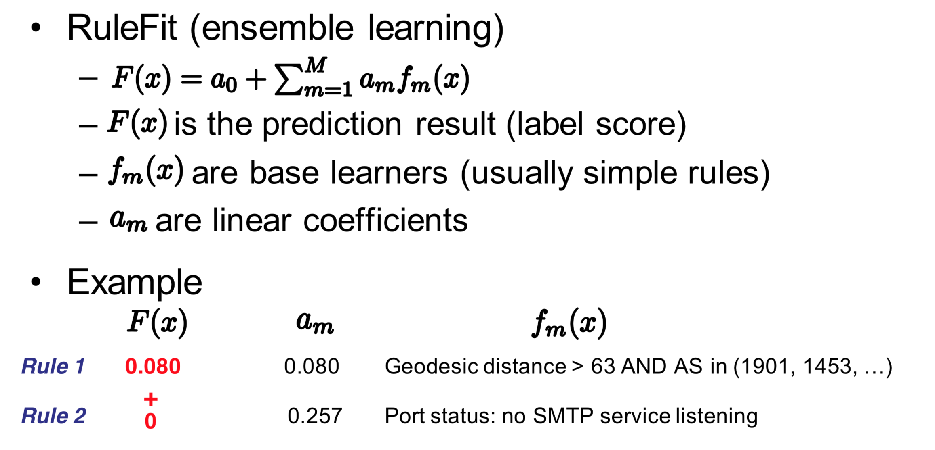
Supervised Learning: RuleFit

Slide 43
Combining Features: RuleFit
Put features into the RuleFit classifier
10-fold cross validation on one day of query logs from a large spam filtering appliance provider
Comparable performance to SpamHaus
Incorporating into the system can further reduce FPs
Using only network-level features
Completely automated

Slide 44
Benefits of Whitelisting
Whitelisting top 50 ASes: False positives reduced to 0.14%

Slide 45
Ranking of Features

Slide 46
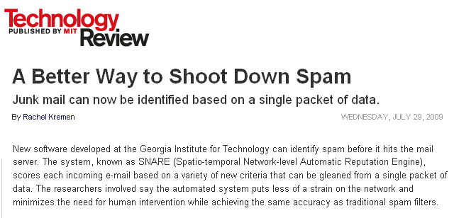
SNARE: Putting it Together
Email arrival
Whitelisting
Greylisting
Retraining

Slide 47
Automated Filtering of Spam
Network-level features to train RuleFit classifier
Comparable performance to manual blacklists
Using only network-level features
Completely automated
Hao, Shuang, et al. "Detecting Spammers with SNARE: Spatio-temporal Network-level Automatic Reputation Engine." USENIX security symposium. Vol. 9. 2009.

Slide 48
Day 2: Unsupervised Learning

Slide 49
Characteristic of Spam: Coordination
Idea: Blacklist sending behavior (“Behavioral Blacklisting”)
Identify sending patterns commonly used by spammers
Intuition: More difficult for a spammer to change the technique by which mail is sent than it is to change the content

Slide 50
Clustering Spam Senders
Construct a behavioral fingerprint for each sender
Cluster senders with similar fingerprints
Filter new senders that map to existing clusters

Slide 51

SpamTracker: Identify Invariant
IP Address: 76.17.114.xxx
Known Spammer
IP Address: 24.99.146.xxx
Unknown sender
DHCP
Reassignment
spam
spam
spam
spam
spam
spam
Infection
domain1.com
domain2.com
domain3.com
domain1.com
domain2.com
domain3.com
Cluster on
sending behavior
Cluster on
sending behavior
Behavioral fingerprint
Similar fingerprint!
Notes:
make fonts bigger

Slide 52
Building the Classifier: Clustering
Feature: Distribution of email sending volumes across recipient domains
Clustering Approach
Build initial seed list of bad IP addresses
For each IP address, compute feature vector: volume per domain per time interval
Collapse into a single IP x domain matrix:
Compute clusters

Slide 53
Principal Components
All principal components (PCs) start at the origin of the ordinate axes.
First PC is direction of maximum variance from origin
Subsequent PCs are orthogonal to 1st PC and describe maximum residual variance
30
25
20
Wavelength 2
15
PC 1
10
5
0
0
5
10
15
20
25
30
Wavelength 1
30
25
20
Wavelength 2
15
PC 2
10
5
0
0
5
10
15
20
25
30
Wavelength 1

Slide 54
Principal Component Analysis
From k original variables: x₁,x₂,...,x_{k}:
Produce k new variables: y₁,y₂,...,y_{k}:
y₁ = a₁₁x₁ + a₁₂x₂ + ... + a_{1k}x_{k}
y₂ = a₂₁x₁ + a₂₂x₂ + ... + a_{2k}x_{k}
...
y_{k} = a_{k1}x₁ + a_{k2}x₂ + ... + a_{kk}x_{k}

Slide 55
Principal Component Analysis
From k original variables: x₁,x₂,...,x_{k}:
Produce k new variables: y₁,y₂,...,y_{k}:
y₁ = a₁₁x₁ + a₁₂x₂ + ... + a_{1k}x_{k}
y₂ = a₂₁x₁ + a₂₂x₂ + ... + a_{2k}x_{k}
...
y_{k} = a_{k1}x₁ + a_{k2}x₂ + ... + a_{kk}x_{k}
such that:
y_{k}'s are uncorrelated (orthogonal)
y₁ explains as much as possible of original variance in data set
y₂ explains as much as possible of remaining variance
etc.

Slide 56
2nd Principal
Component, y₂
1st Principal
Component, y₁

Slide 57
PCA Scores
x_{i2}
y_{i,1}
y_{i,2}
x_{i1}

Slide 58
PCA Eigenvalues
λ₂
λ₁

Slide 59
Clustering: Output and Fingerprint
For each cluster, compute fingerprint vector:
New IPs will be compared to this “fingerprint”
IP x IP Matrix: Intensity indicates pairwise similarity

Slide 60
Clustering Results
Ham
Spam
Separation may not be sufficient alone, but could be a useful feature
SpamTracker Score

Slide 61
Internet Censorship (Extra Content)

Slide 62
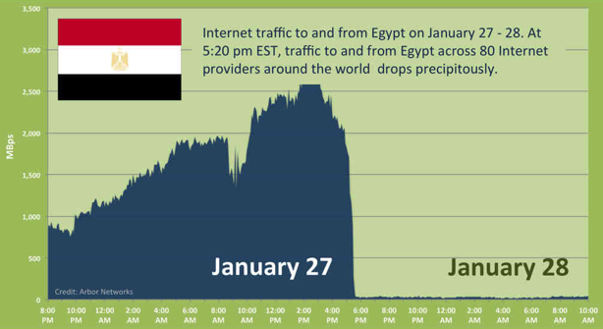
Notes:
2011

Slide 63



Controlling Protocols: Internet “Kill Switch” / Filtering
Censor
Censor
Firewall
Alice
Block Traffic
Bob
Censored net
Uncensored net
Punish User
Notes:
“Ok so now I’m going to give you a brief primer on Internet censorship and some existing approaches taken to overcome it.”
“Suppose Alice wants to get some content from Bob. If she accesses the Internet from behind a censorship firewall then the censor may monitor or block communication with Bob, and may even punish Alice for trying to communicate with Bob.”

Slide 64
Might We Ever Have an Internet “Kill Switch?

Slide 65
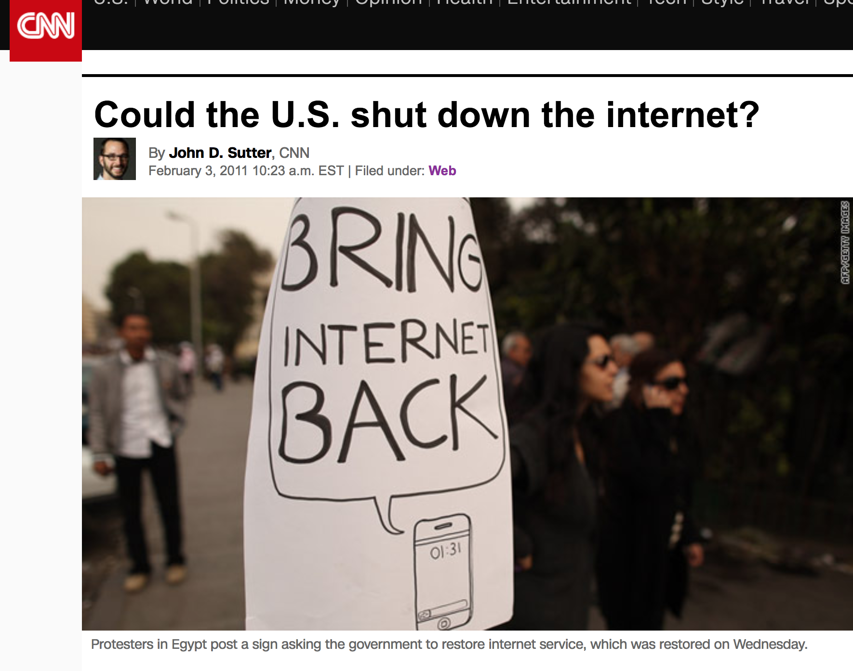

Slide 66
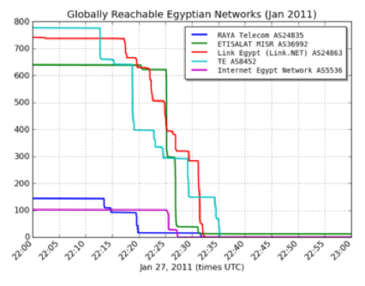
The Internet “Kill Switch”: Take 1
Source: Renesys

Slide 67
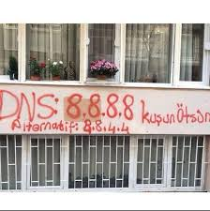
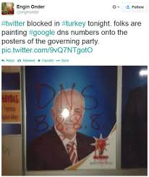
The Internet “Kill Switch”: Take 2

Slide 68
Questions About Protocol Control
How widespread is Internet censorship?
How variable is it, in space and time?
How do countries implement censorship?
What are the trends in censorship and (more broadly) information manupulation?
What can citizens and users do about it?

Slide 69
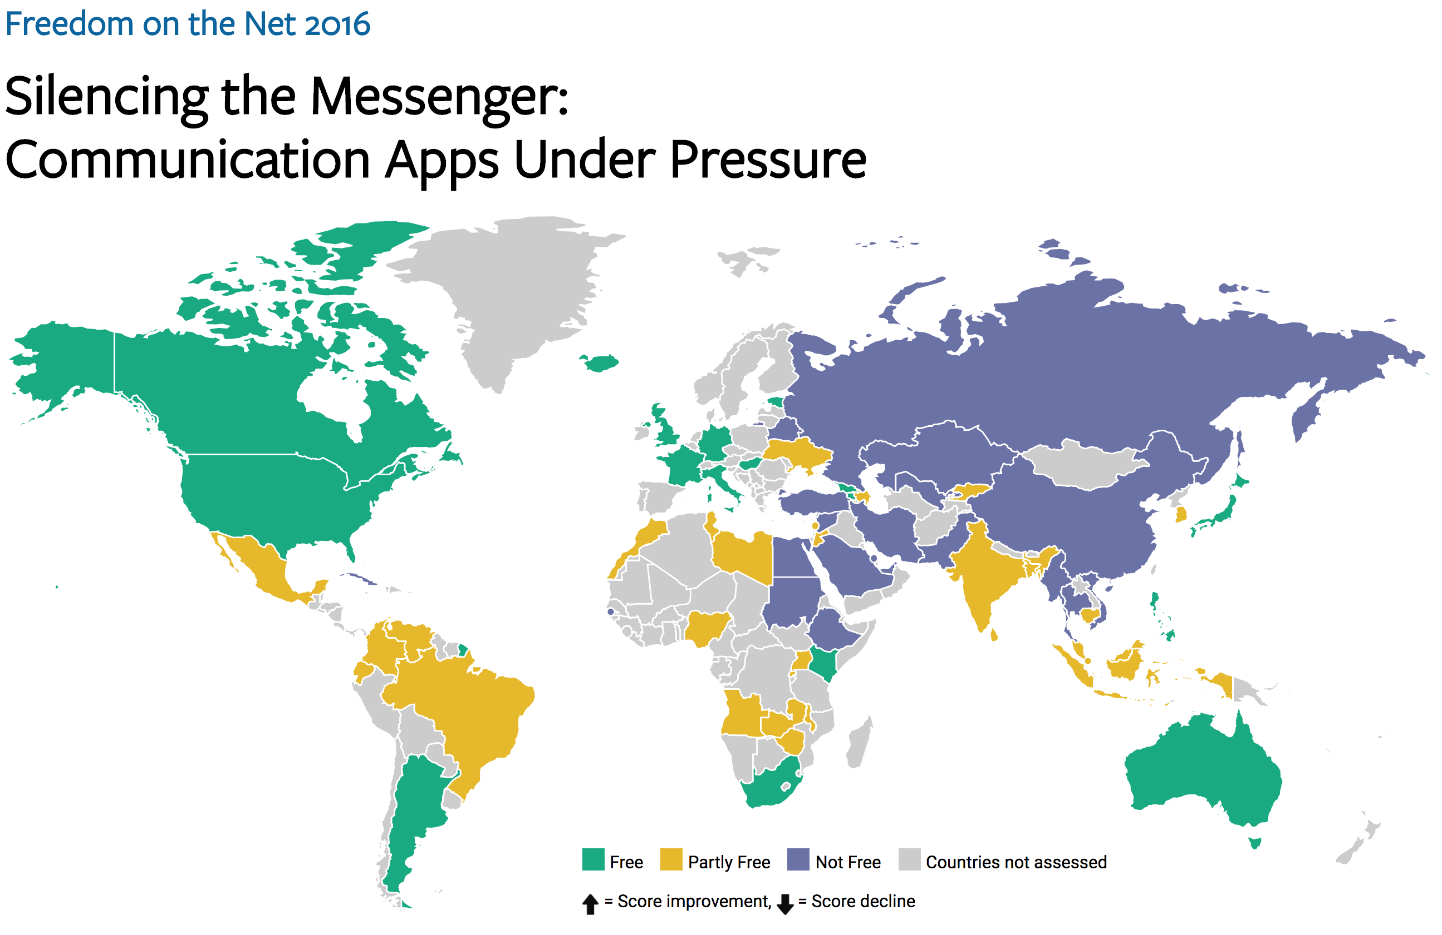

Slide 70
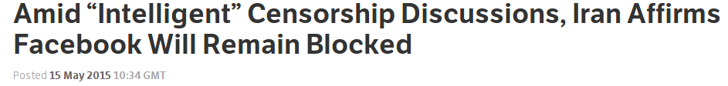
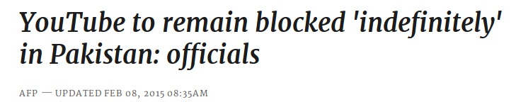
Knowledge of censorship often
begins and ends with anecdotes
Notes:
Examples of Web censorship across the globe continuously pop up in the news, as recently as a week ago. Unfortunately, our knowledge of these events both begins and ends with anecdotes.

Slide 71


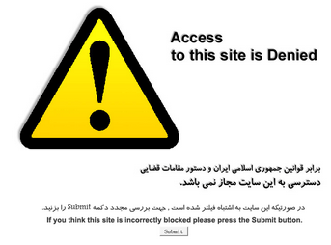
Wanted: More than Anecdotes…
What is censored?
Where is it censored?
When is it censored?
How is it censored?
Iran
2009
Notes:
We’d like to move beyond that. For any instance of censorship, researchers hope to learn four things: What is censored, Where it’s censored, When it was censored, and How it’s being censored. For example, in one persistent example, YouTube has been blocked in Pakistan since September of 2012. It’s often enforced via DNS injection to show users a block page like this one.

Slide 72
Moving Beyond Anecdotes is Hard
Many locations, languages, and cultures
Recruiting lots of vantage points is necessary but hard
Many censorship mechanisms
Measurements must be flexible
A big challenge is diversity

Slide 73





Censorship Measurement Today
Anecdote
(Twitter censored in Iran)
Researcher
Custom measurement software
Vantage points
Censor
Web service
Notes:
The biggest drawback is scale
Still effectively anecdotes
Political and social scientists want more data
The Citizen Lab, Berkman Center, Princeton, etc.

Slide 74

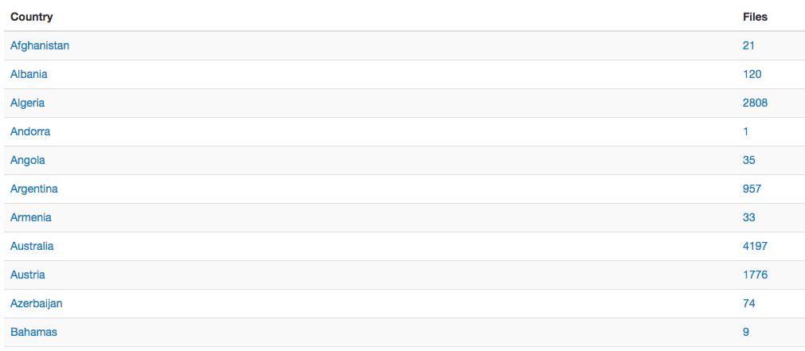
State of the Art: OONI

Slide 75

Encore: Measure Using Web Browsers
Anecdote
(Twitter censored in Iran)
Custom software
Researcher
Every Web browser is a potential vantage point
Instrumented
Web page
<iframe
src="//encoreenco.re/task.html"
width="0" height="0"
style="display: none">
</iframe>
Volunteer Web site
Vantage points
Censor
Web service

Slide 76
How Encore Works
Origin Web site
GET /
Vantage point
“Can you access http://twitter.com?”
http://encoreenco.re
Web browser
in Iran
Cross-origin
GET /favicon.ico
Measurement target
How?
Censor
http://twitter.com
Burnett, Sam, and Nick Feamster. "Encore: Lightweight measurement of web censorship with cross-origin requests." ACM SIGCOMM. 2015

Slide 77
Same-Origin Policy
An origin is a tuple: (protocol, hostname, port)
https://twitter.com → (https, twitter.com, 443)
Browsers prevent cross-origin data reads:
AJAX requests
Inspection of iframe contents
Cookies and local storage

Slide 78
Encore Doesn’t Need to Read Data
It only needs to know whether a URL loaded.
Restrictions on resource embedding are looser.
Examples:
Images with <img>
Style sheets with <style>
Arbitrary content with <iframe>

Slide 79

Ways to Censor Twitter
Domains
NXDOMAIN
Drop request
Inject response
Q: twitter.com?
R: 185.45.5.43
DNS
resolver
IP addresses
TCP SYN
Censor
Send RST
Drop SYN
User
TCP SYN-ACK
HTTP GET /
URLs
HTTP 200 OK
Send RST
Drop GET
HTTP 302
twitter.com
Web server

Slide 80
Inferring Censorship
Domains
NXDOMAIN
Drop request
Inject response
Many images, same domain
Q: twitter.com?
R: 185.45.5.43
DNS
resolver
IP addresses
TCP SYN
Many images, same IP
Send RST
Drop SYN
User
TCP SYN-ACK
HTTP GET /
URLs
HTTP 200 OK
Send RST
Drop GET
HTTP 302
Load URLs in iframe
twitter.com
Web server

Slide 81
Ethics (another full lecture…)

Slide 82
Can We Reduce Encore’s Risks?
Risk depends on usage
What URLs we ask users to measure
Which users run those measurements
Low-risk use cases
URLs often loaded with cross-origin requests
Scalable network availability monitoring

Slide 83
Encore: Summary
Encore enables measurement of Web censorship using ordinary Web browsers as vantage points.
A technique for measuring censorship at scale
A censorship emulation testbed
Open source software
https://github.com/noise-lab/encore

Slide 84
Control of Online Communication
Controlling Protocols Filtering and manipulation of Internet protocols
HTTP, TCP/IP, DNS
Circumvention tools (e.g., Tor)
Controlling Attention Filtering and manipulation on Internet platforms
Filter bubbles
Personalization (and attacks)
Automated filtering

Slide 85



TCP/IP
TCP Handshake:
SYN-ACK
RST
SYN [IP ID:X]
Port status is open/closed
SYN/ACK [IP ID: Y]
ACK [IP ID:X+1]
SYN
SYN/ACK
SYN/ACK
SYN/ACK
Port status is open
Notes:
First some backgrounds:
Remember the TCP uses a three way handshake. Though You might not remember that each packet has IPID field, a 16 bits that is used for fragmentation reasons. I will use this field later.
Following tcp protocol states if I send an unsolicited SA to a host , then it should respond with a RST.
And finally if I send a syn to site with open port, it responds with SA. If I don’t send Ack or RST, because TCP is reliable the site retransmit synack multiple times
These are the properties of network protocol that I plan to leverage in Spooky scan and consequently Auger.

Slide 86
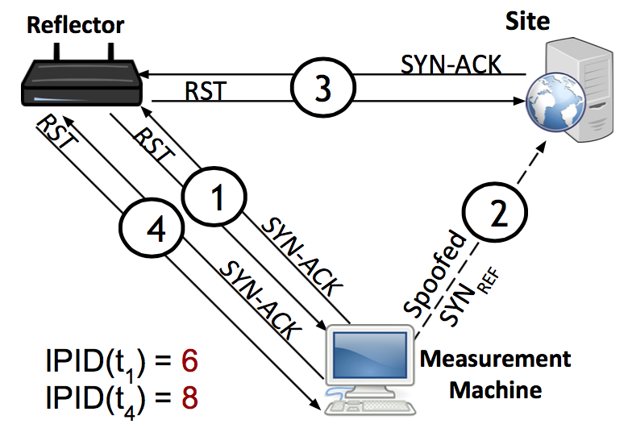
Key Observation: IP ID Increment
Global IP ID for reflector
Increments for each packet sent
We can perturb this counter from a remote location
Continually probe reflector for IP ID value
Spoof packets from the measurement machine
Appear to come from reflector
Behavior under “normal” reachability
Notes:
The strategy behind our method is to leverage the fact that when an Internet host generates and sends IP packets, each generated packet contains a 16-bit IP identifier (“IP ID”) value that is intended to assist endpoints in re-assembling fragmented IPv4 packets.

Slide 87



Augur Requirements
“User” (Reflector)
Must maintain a global value for IP ID
Site
Open port and retransmitting SYN-ACKs
Measurement Machine
Must be able to spoof packets
Notes:
For spooky scan, the user doesn't need to be end user so we adopt the word reflect from now on.
The reflector must maintain a single global counter to generate IPID values regardless of destination IPs. The value of this counter at anytime reflects how many packets it has generated.
These requirements are very easy to satisfy.

Slide 88

“Normal”: No Blocking
Probe [IP ID: 7003]
Augur
6
SYN/ACK
7
RST [IP ID: 7002]
No direction blocked
1
SYN/ACK
Reflector IP ID:
7000
7001
7002
7003
2
RST [IP ID: 7000]
Measurement machine
Reflector
3
SYN/ACK
Spoofed SYN [src: Reflector IP]
4
5
RST [IP ID: 7001]
Site

Slide 89
Inbound Blocked
Probe [IP ID: 7002]
5
SYN/ACK
6
RST [IP ID: 7001]
1
SYN/ACK
Reflector IP ID:
7000
7001
7002
2
RST [IP ID: 7000]
Measurement machine
Reflector
3
Spoofed SYN [src: ClientIP]
SYN/ACK
4
Site
Notes:
We can get a sample of IP ID.

Slide 90
Outbound Blocked
6
SYN/ACK
7
RST [IP ID: 7002]
1
SYN/ACK
Reflector IP ID:
7000
7001
7002
2
RST [IP ID: 7000]
Measurement machine
3
5
RST
Spoofed SYN [src: ClientIP]
SYN/ACK
4
Site
Notes:
We can get a sample of IP ID.

Slide 91
Outbound Blocked
Probe [IP ID: 7004]
6
SYN/ACK
7
RST [IP ID: 7002]
1
SYN/ACK
Reflector IP ID:
7000
7001
7002
7003 7004
2
RST [IP ID: 7000]
Measurement machine
3
5
RST
Spoofed SYN [src: ClientIP]
SYN/ACK
4
Site
Notes:
We can get a sample of IP ID.

Slide 92
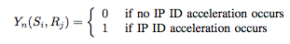
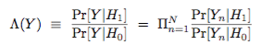
Statistical Detection: Max Likelihood
Random variable: IP ID acceleration
Detect the presence or absence of a prior (in this case, our perturbation), based on the separation of distributions of values under the prior.
Detection framework: Statistical Hypothesis Testing
Assumptions: IP ID acceleration is stationary, i.i.d.
Randomization of trail order, run trials over a course of weeks
Likelihood ratio:

Slide 93
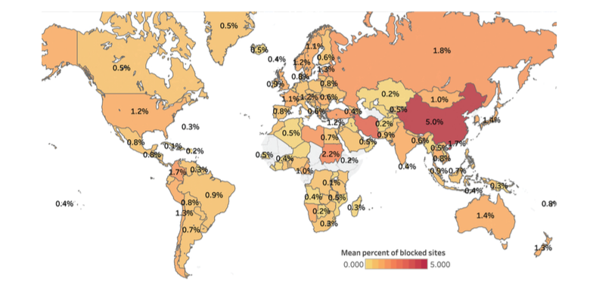
Pearce, Paul, et al. "Augur: Internet-Wide Detection of Connectivity Disruptions." Security and Privacy (SP), 2017 IEEE Symposium on. IEEE, 2017.
Notes:
Global heat map showing the percentage of sites filtered for any client in countries around the world. China experiences the highest average amount of filtering, at 5% of measurable sites filtered by a resolver within the country.

Slide 94
DNS Overview: Mapping Names to Addresses
www.cs.princeton.edu
root, .edu
www.cs.princeton.edu
NS dns.princeton.edu
NS dns1.cs.princeton.edu
dns.princeton.edu
Client
Local
DNS resolver
A 128.112.136.35
dns1.cs.princeton.edu
DNS is not secured! Possible for manipulation attacks to occur.

Slide 95
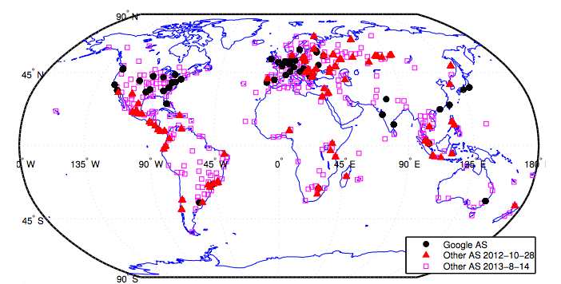
Detecting DNS Manipulation
Strawman: Find instances where the IP address returned does not agree with the “right answer”.
Problem: There is not a single right answer…
Extreme example: IP addresses returned for google.com (Katz-Bassett et al.)
Pearce, Paul, et al. "Global Measurement of DNS Manipulation." 26th {USENIX} Security Symposium ({USENIX} Security 17). USENIX} Association, 2017.

Slide 96
Consistency Metrics
IP Address
Autonomous System (“ISP”)
HTTP Content returned
Consistency of HTTPS certificate
Reverse DNS lookup (IP address to name)

Slide 97
Independently Verifiable Metrics
Content of HTTPS Certificate
Does the IP address present a correct domain in a valid, browser-trusted certificate
Same test, but with certificate fetched with SNI (the domain name)

Slide 98
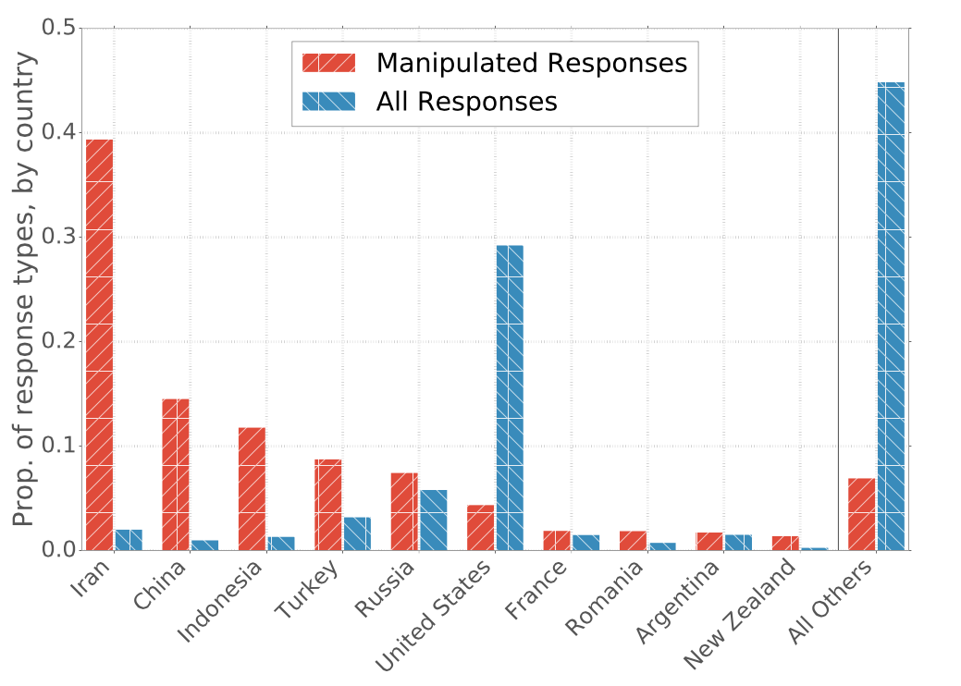
Prevalence of Manipulation by Country

Slide 99
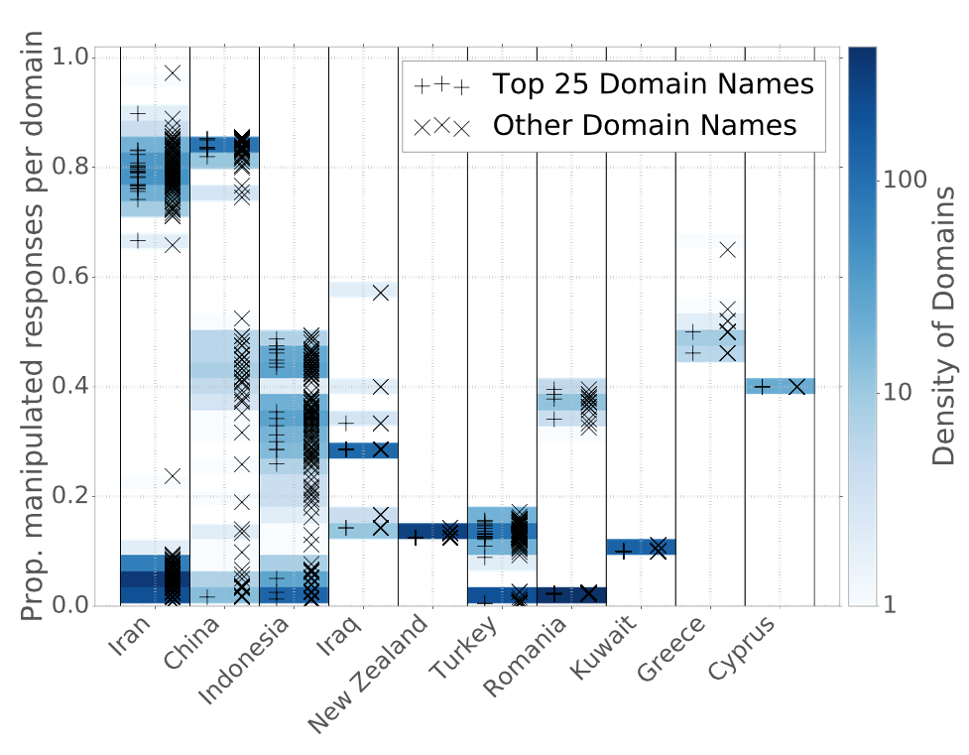
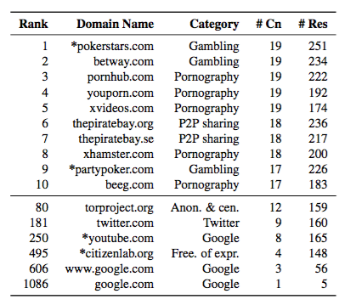
Manipulation of Domains within Countries
Notes:
----- Meeting Notes (4/14/17 13:50) -----
Need a version of this plot by category.

